Slide 1
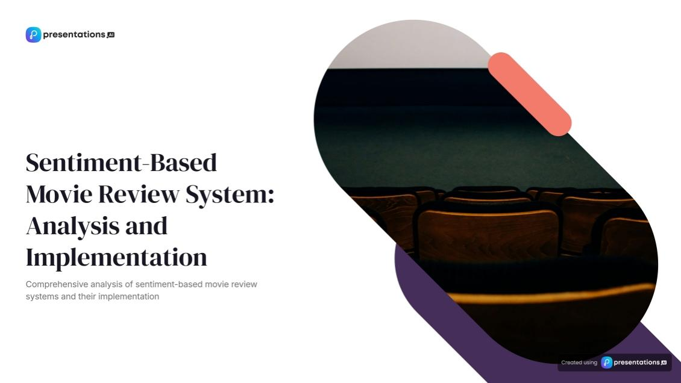
CSA0279
C Programming for Beginners
Mohammed Imaz Zain Y (192212406)
Auxi Geo J (192212406)

Slide 2
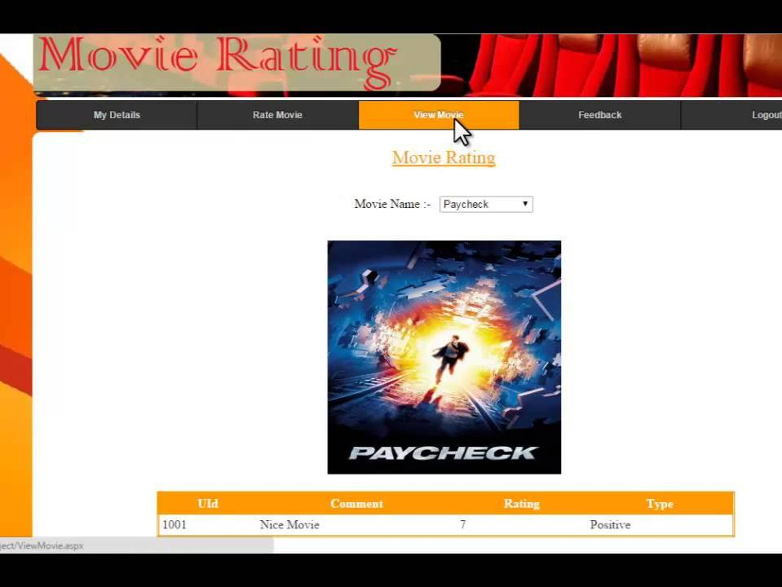
Problem Statement
With the overwhelming volume of movie reviews available online, it can be challenging for viewers to find films that align with their preferences and tastes. Traditional rating systems often rely on numerical scores or star ratings, which may not fully capture the nuanced opinions expressed in written reviews. This can lead to misinterpretations of a film's quality and impact viewers' decisions about which movies to watch.
The objective of this project is to develop a Sentiment-Based Movie Rating System that will provide a more accurate representation of a movie’s reception, allowing users to make informed decisions about their viewing choices. This approach aims to enhance the movie-watching experience by presenting a deeper understanding of audience sentiments.
Requirements:
Implementation of natural language processing techniques for text preprocessing and analysis. Development of sentiment analysis algorithms to classify reviews as positive, negative, or neutral. User-friencdly interface for browsing movies and viewing sentiment-based ratings.
Integration of user ratings and reviews to refine and improve sentiment assessments.
Visualization tools for displaying sentiment trends over time for specific movies.
Reporting features for filmmakers and studios to gain insights into audience perceptions.
Ability to integrate with existing movie databases for comprehensive film information.”

Slide 3
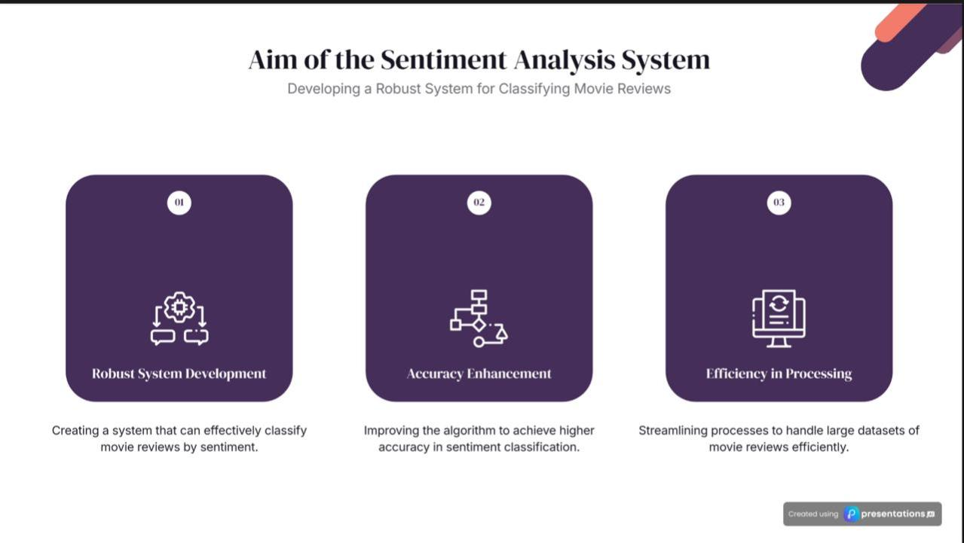

Slide 4
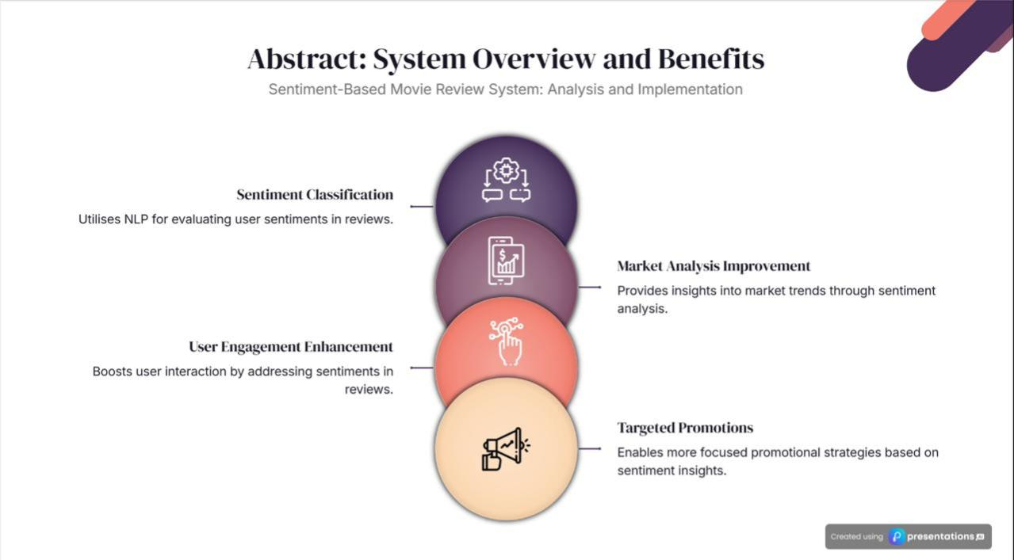
A Sentiment-Based Movie Review System is designed to analyse and classify user reviews of movies into positive, negative, or neutral categories. By leveraging sentiment analysis, this system provides valuable insights into audience opinions, enabling informed decision-making for the entertainment industry. This paper presents a foundational implementation of such a system using C programming, focusing on sentiment classification, market analysis improvement, user engagement enhancement, and targeted promotion.
The system aids in improving market analysis by processing large volumes of user reviews to identify trends and patterns in audience preferences. For example, producers can detect recurring themes in positive reviews or address common criticisms found in negative feedback. This data-driven approach helps filmmakers and distributors align their strategies with audience expectations.
By analyzing sentiment, the system can suggest personalized recommendations to users. For instance, users who consistently provide positive reviews for a specific genre or director can receive tailored suggestions for similar movies. This targeted engagement fosters a deeper connection between users and the platform.
Insights from sentiment analysis can inform promotional strategies. For example, movies receiving predominantly positive reviews can be prioritized for wider marketing campaigns, while those with negative feedback can focus on addressing specific concerns. Targeted promotions based on user sentiment enhance marketing efficiency and boost return on investment.

Slide 5
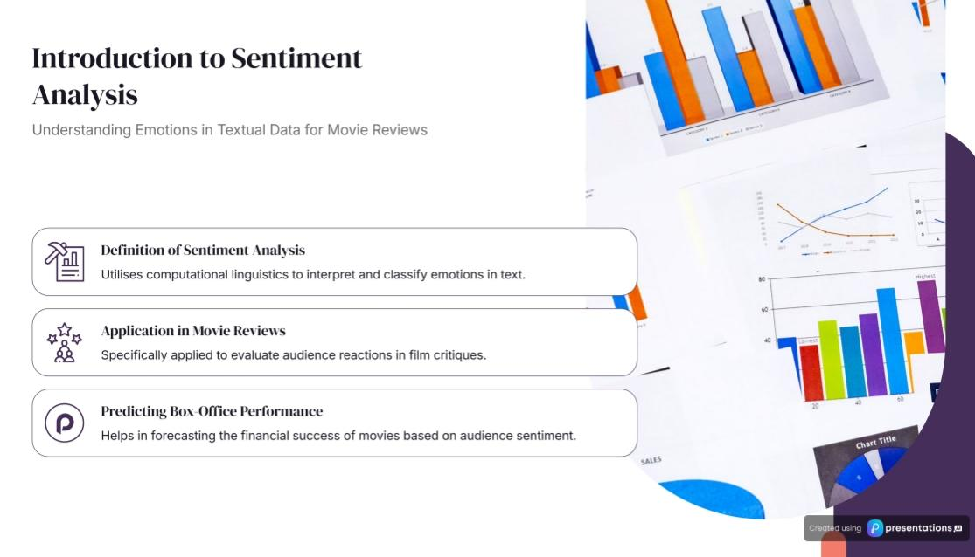
A Sentiment-Based Movie Review System is an application designed to classify and analyze movie reviews based on their sentiment—whether they are positive, negative, or neutral. Such a system can process user-generated textual data to gauge opinions about movies. This application is useful for various stakeholders, such as filmmakers, marketers, and moviegoers, to better understand public perception.
While sentiment analysis is often implemented using high-level languages and advanced libraries for natural language processing (NLP), creating a simplified version in C programming involves using basic string manipulation, file handling, and algorithmic approaches to classify reviews.
Key Features of the System
Input Handling: Accepts user-provided movie reviews through a file or directly from the console.
Keyword Matching: Uses predefined sets of positive and negative keywords to evaluate the sentiment of a review.
Classification: Categorizes the review based on the count of positive and negative words.
Output: Displays whether the review is positive, negative, or neutral.

Slide 6
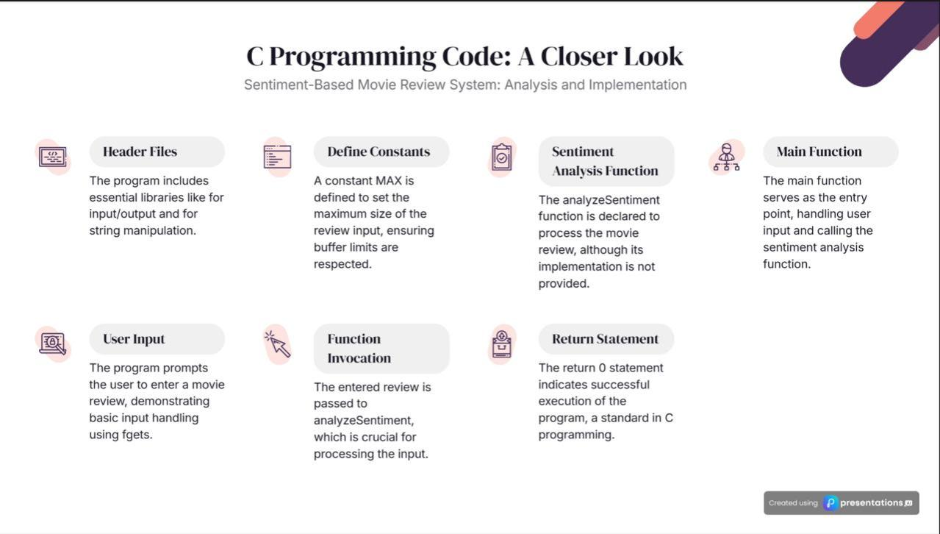
Developing a Sentiment-Based Movie Review System in C involves analyzing textual reviews to classify sentiments as positive, negative, or neutral. Below is a structured approach to implementing such a system:
1. Define Sentiment Keywords
Create arrays to store positive and negative keywords that will help in sentiment classification.
const char *positiveKeywords[MAX_KEYWORDS] = {“amazing”, “great”, “excellent”, “fantastic”, “good”};
const char *negativeKeywords[MAX_KEYWORDS] = {“bad”, “poor”, “boring”, “terrible”, “horrible”};
2. Function to Convert Text to Lowercase
To ensure case-insensitive comparison, implement a function to convert text to lowercase.
void toLowerCase(char *str) { for (int i = 0; str[i]; i++) { str[i] = tolower((unsigned char)str[i]); } }
3. Function to Count Keyword Occurrences
Implement a function to count occurrences of keywords in a given review.
4. Function to Classify Sentiment
Based on the counts of positive and negative keywords, classify the sentiment.
Void classifySentiment(int positiveCount, int negativeCount) { if (positiveCount > negativeCount) { printf(“Sentiment: Positive\n”); } else if (negativeCount > positiveCount) { printf(“Sentiment: Negative\n”); } else { printf(“Sentiment: Neutral\n”); } }
5. Main Function to Integrate Components
Combine all components in the main function to process user input and display the sentiment.
6. Compilation and Execution
To compile and run the program, use the following commands:
The classifySentiment function compares the counts of positive and negative keywords to determine the sentiment: Positive: If positive count > negative count. Negative: If negative count > positive count. Neutral: If positive count == negative count.

Slide 7
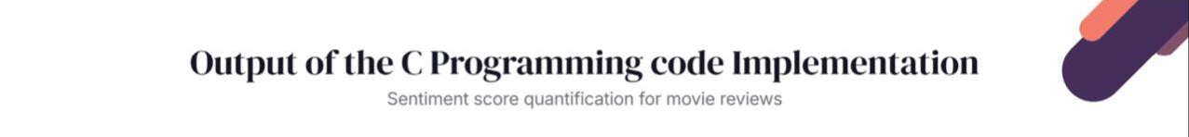
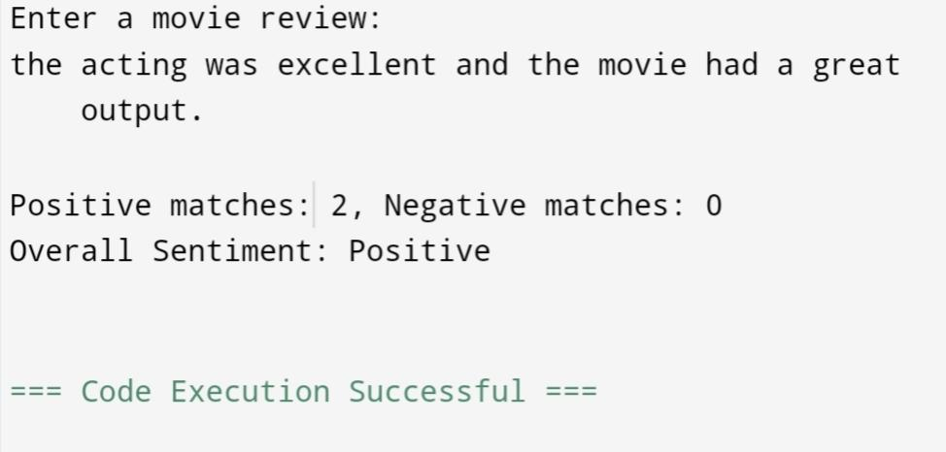
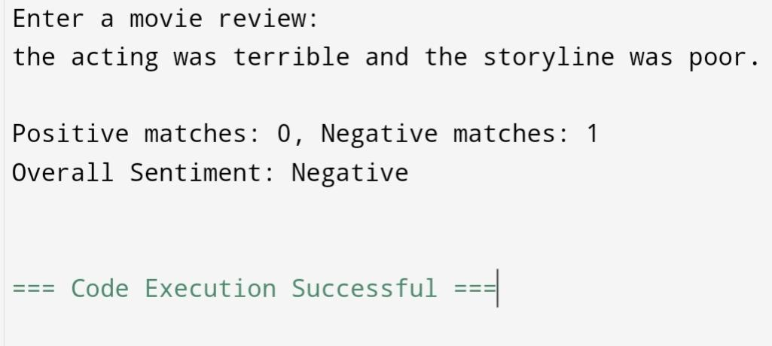
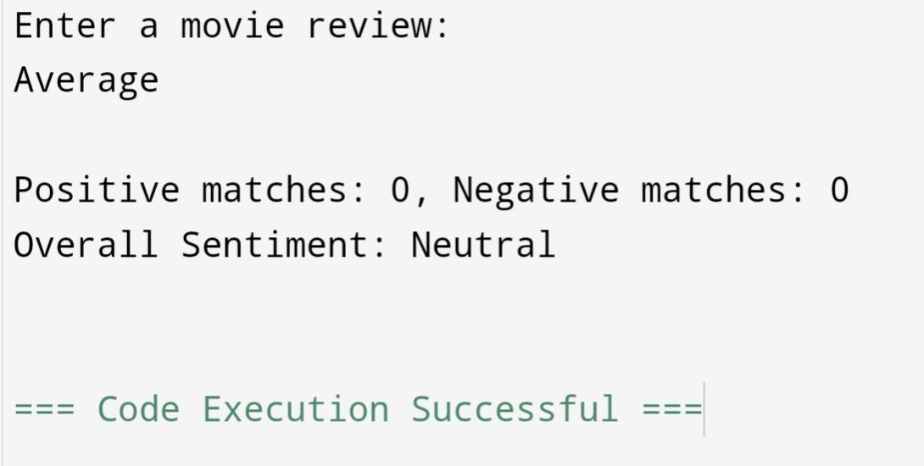

Slide 8

1. Basic C programming Engineering standards for Language Compliance
The ISO/IEC 9899 standards define the core language syntax, semantics, and library functions for C. Following these guidelines ensures consistent behaviour across compilers and platforms.
Key Points for Compliance
Strict Adherence to ISO Standards Follow the specific version of the standard being used (e.g., C90, C99, C11).
Avoid reliance on non-standard compiler-specific features (e.g., GCC extensions like __attribute__ or #pragma directives) unless absolutely necessary.
Avoid Platform-Specific Code A code that can be compiled and executed across various operating systems and architectures without modification.
Example of a platform-specific issue to avoid:
Using Windows-specific getch() instead of standard input functions. Use Standard Library Functions Use the library functions defined in the ISO/IEC 9899 standard. Avoid using deprecated or non-standard functions.
2. Testing and Validation Standards ISO/IEC/IEEE 29119 – Software Testing Standards
Perform the following types of tests:
Unit Testing: Test individual functions like countKeywords() and classifySentiment().
Integration Testing: Verify the interaction between input, processing, and output modules.
System Testing: Test the entire workflow from input to sentiment classification. Boundary Testing: Test edge cases like empty or overly large reviews.
Test Planning:
Define test objectives, scope (e.g., input validation, sentiment analysis accuracy). Identify risks (e.g., performance for large reviews).
Test Design:
Specify test cases for positive, negative, and edge scenarios.
Create test conditions such as:
Empty reviews. Mixed sentiment reviews. Reviews with no keywords.
Test Execution: Use structured templates to run tests, record results, and log defects.

Slide 9
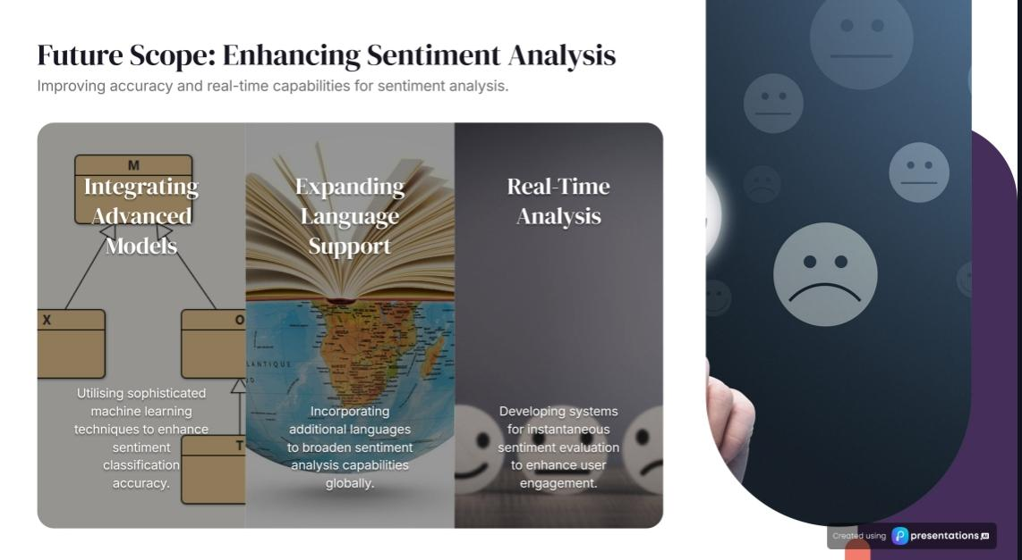

Slide 10
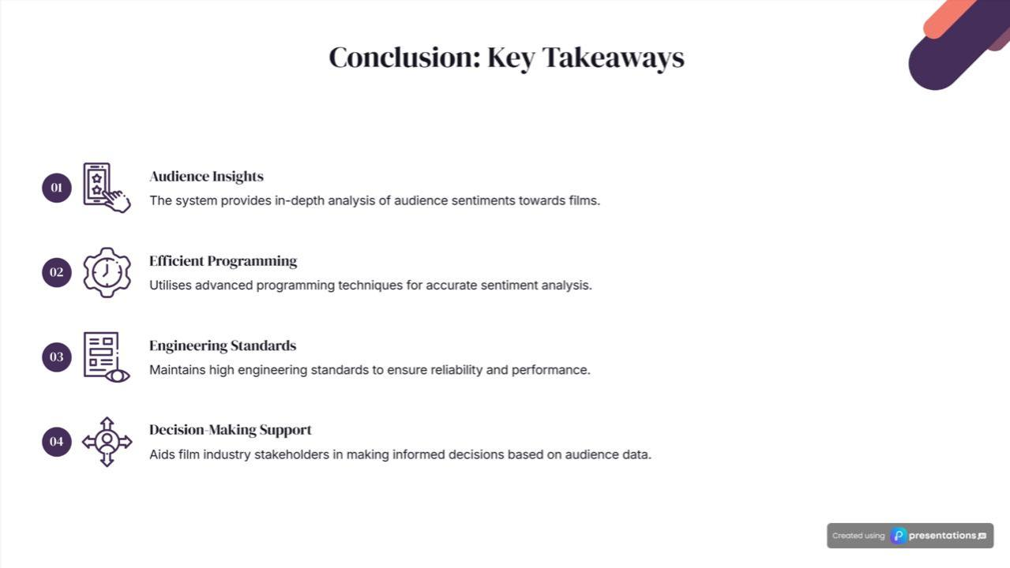

Slide 11
